Slide 1



Week 5
Lasso – Feature Selection
Zachary Chang
University of California, Los Angeles (UCLA)
Contact: zachang890@g.ucla.edu
Physics of AmoRphous and
Inorganic Solids Laboratory

Slide 2
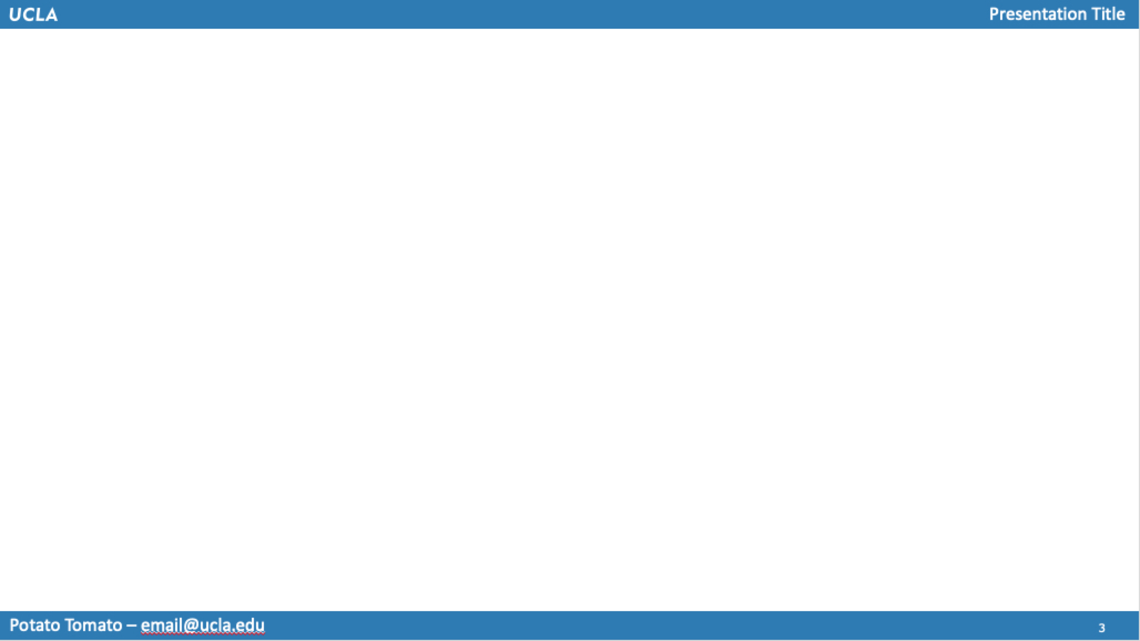

Background & Motivation/Goal
Use LASSO to potentially create a more accurate model to predict Young’s Modulus, Shear Modulus, and Poisson’s Ratio
Type of Data (From Last Week): 1603 x 132 matrix of transformed features (squared, cubed, exponential, etc.)
Goal for the Week: Use transformed data & LASSO to find the best features for prediction

Slide 3
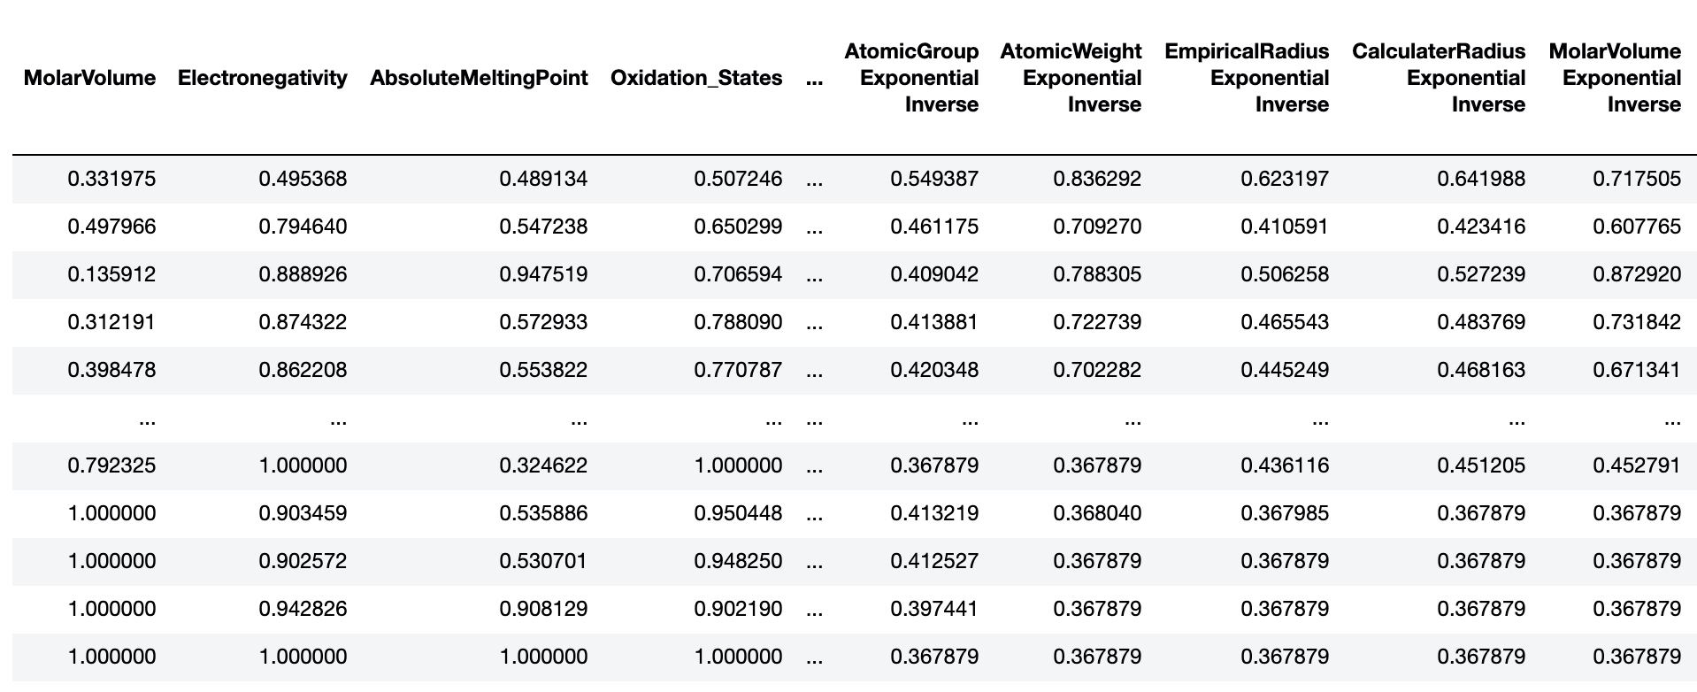
From Last Week
Excerpt from N x P matrix of atomic mol %
Sample of 1603 x 132 Matrix of Transformed Features

Slide 4
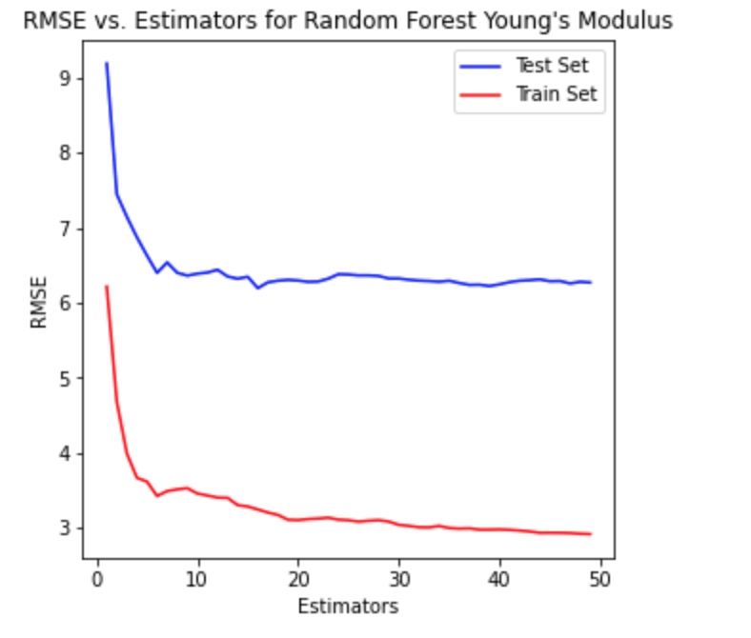
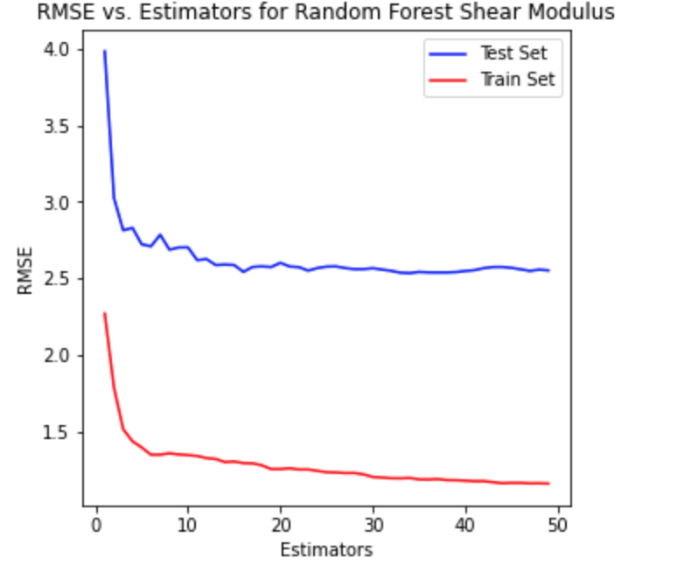
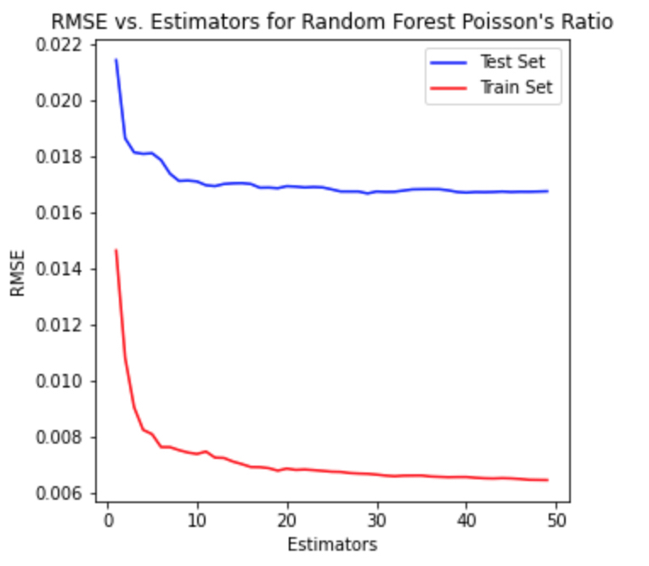
Random Forest Before Feature Sel.
1 – 50 Tree Estimators

Slide 5
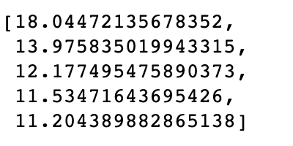
Finding Best Features
Tunable alpha value for LASSO
As suggested, used alpha values: [10⁰, 10⁻¹, 10^{-1.5}, 10⁻², 10^{-2.5}] (did not go smaller for performance sake)
Used random seed values for train test split [1-70 at intervals of 5]
Ran LASSO on each train test dataset, and each alpha value (max_iter = 150k) – found RMSE for each run
Calculated average RMSE across all random seeds
Sample RMSE values for corresponding to each of 5 alpha values (Young’s mod.)

Slide 6
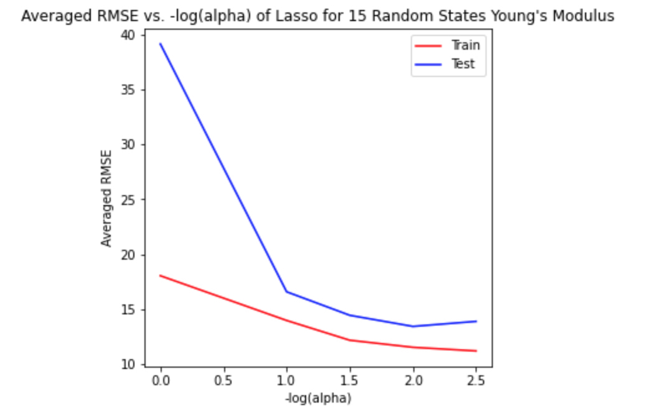
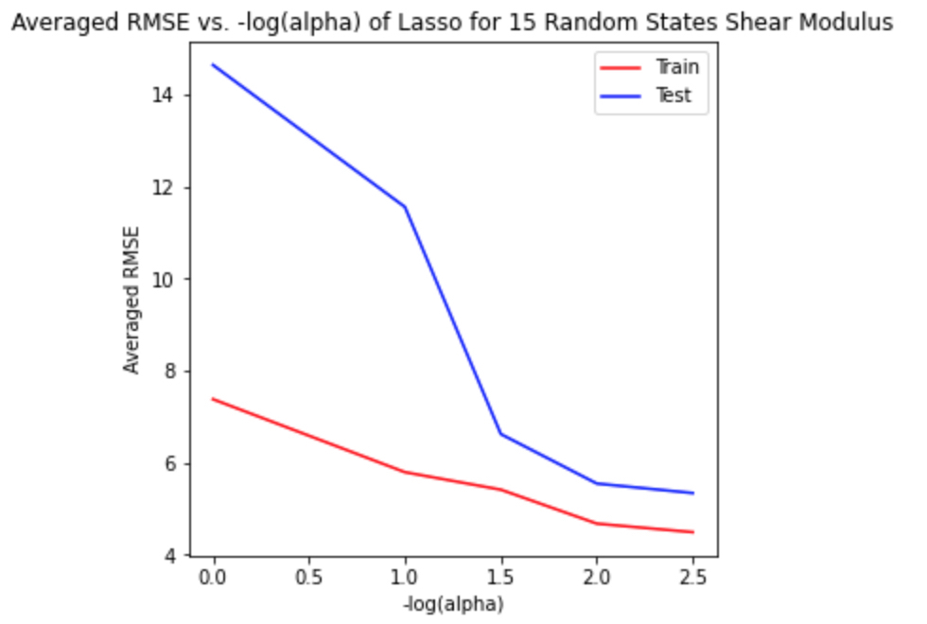
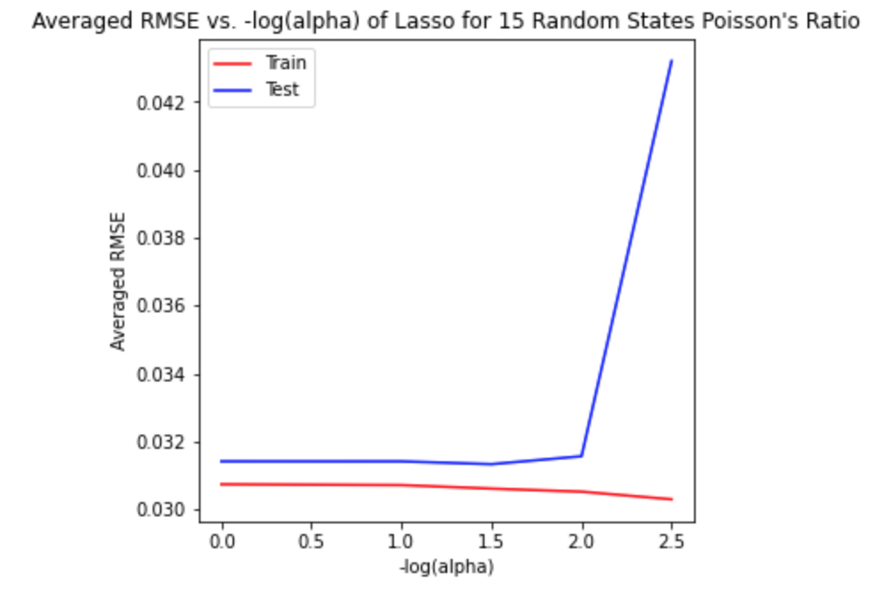
Visualizing RMSE vs. –log(alpha)
(Change in RMSE exaggerated due to small scale)

Slide 7
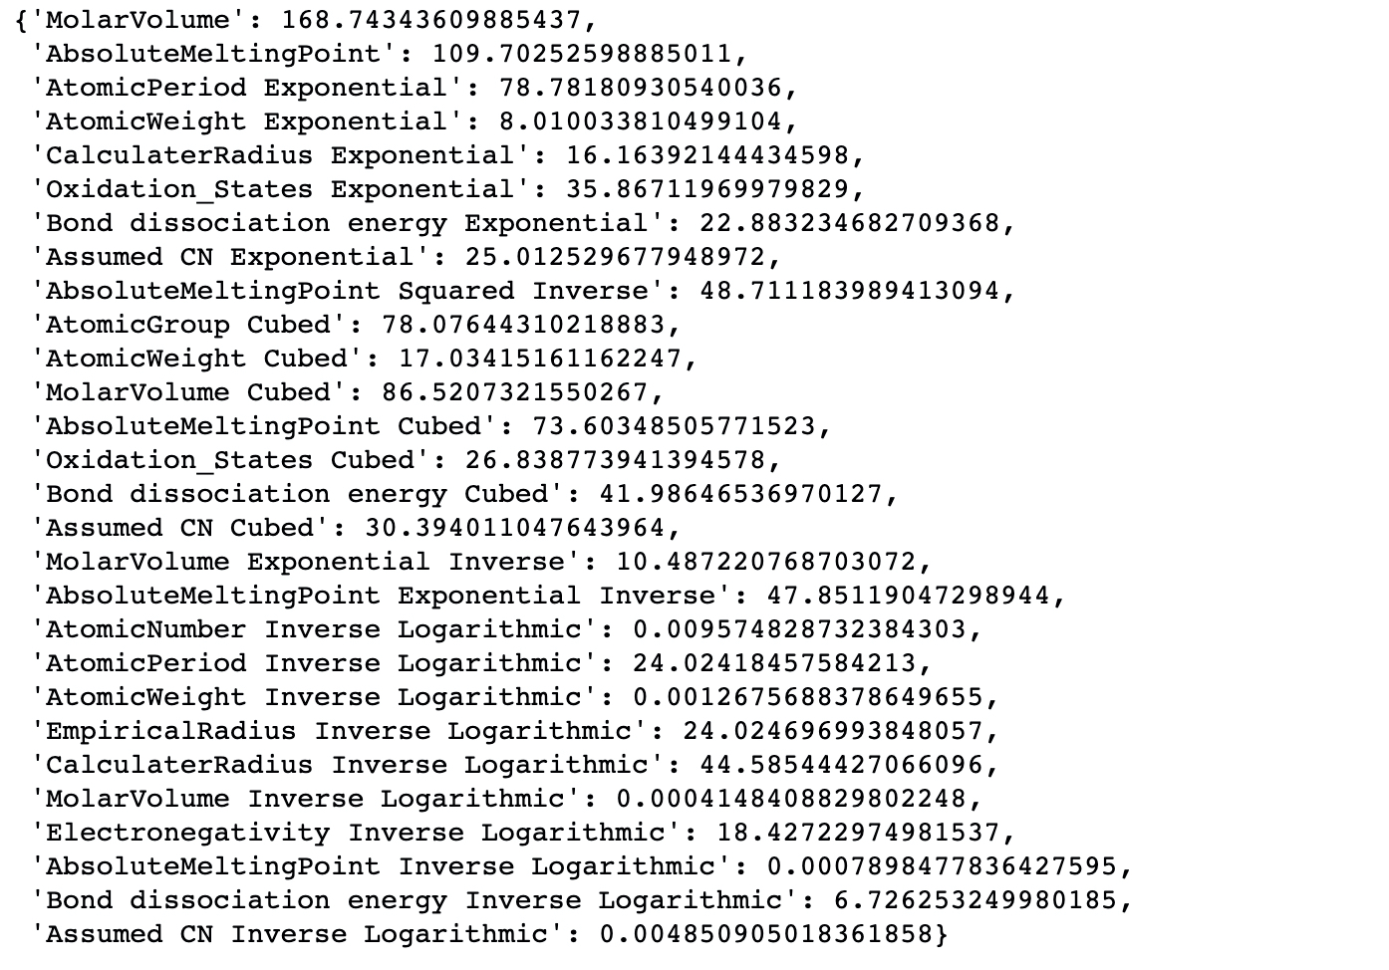
Finding Best Features
Found coefficient values to see which features are best predictors for the values we want to predict
Ranked features by absolute value of coefficients
(Removed features with coefficients of zero)
Picked out top features

Slide 8
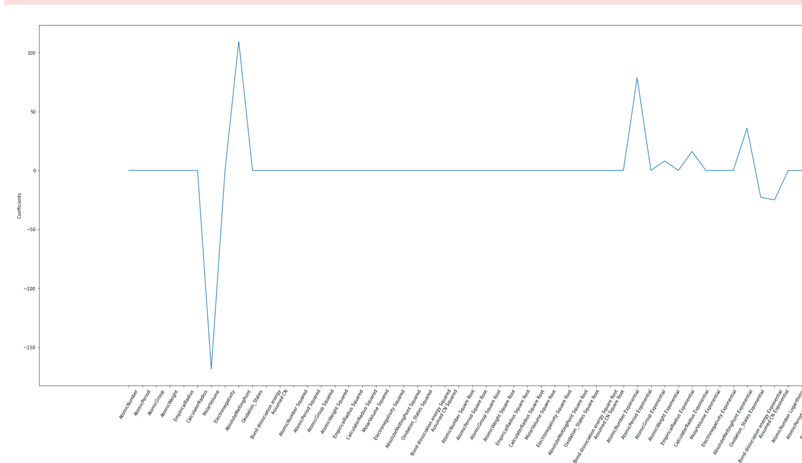
Excerpt of Young’s Mod. Coeffs

Slide 9
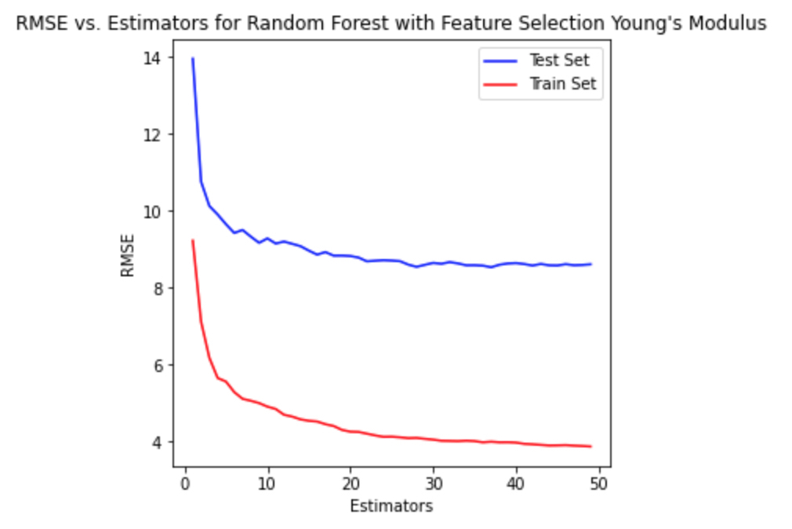
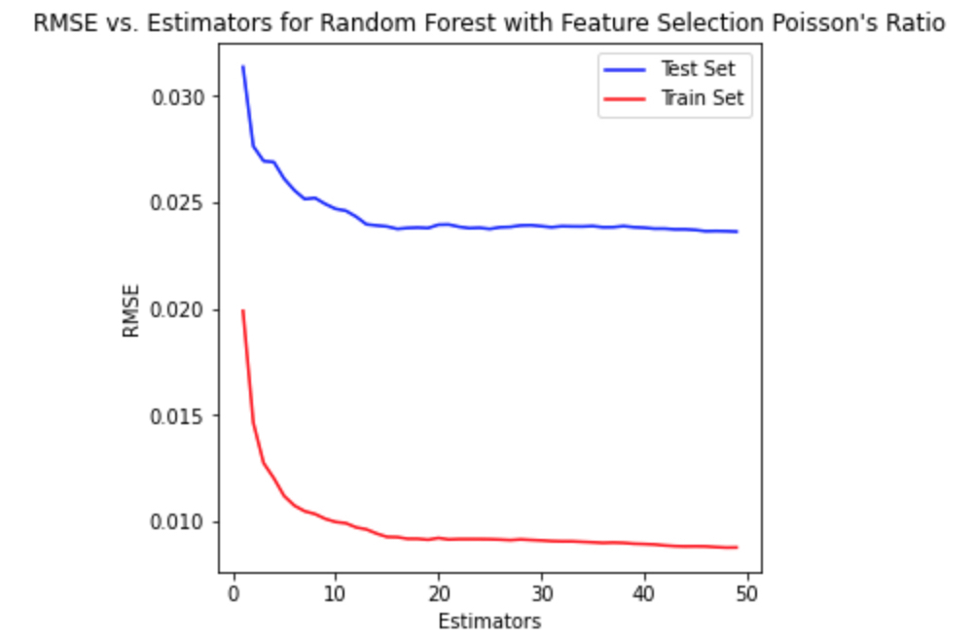
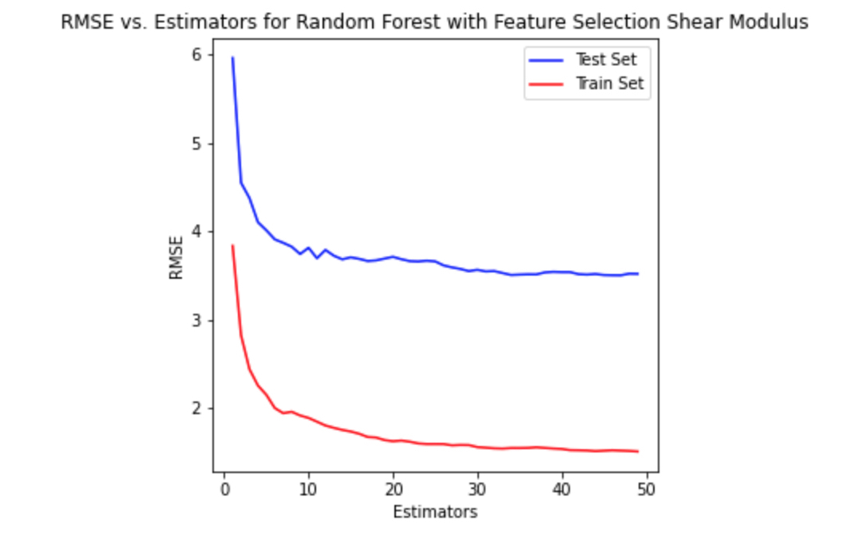
Testing with Selected Features
Random Forest Regressor Pt.2 (To be continued)

Slide 10

Conclusion: Next Steps
List of transformations Used:
Make modifications to the number of selected features used to perform RandomForestRegressor
Possibly add more features to perform predictions
Use more effective regression models besides Random Forest
Use 2nd level and 3rd level feature transformations

